Slide 1

i18n, L10N and Unicode
- Introduction
Siva R Jasthi
ICS499 – Software Engineering and Capstone Project
Information and Computer Sciences
Metropolitan State University
Unrestricted

Slide 2


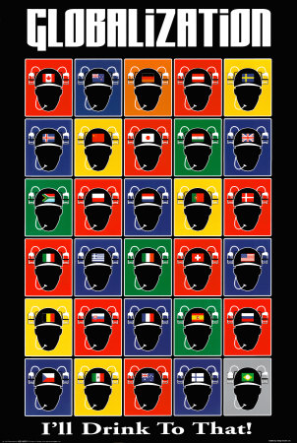

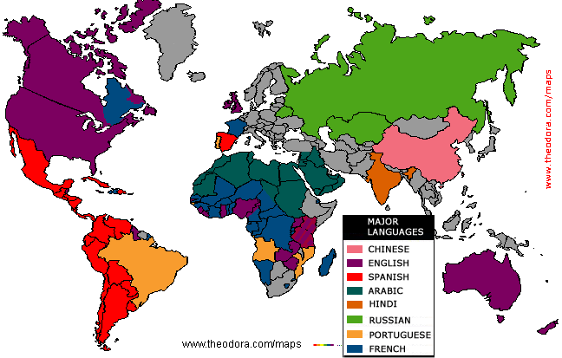
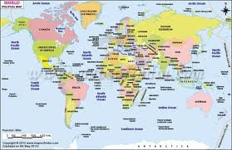

Globalization

Slide 3
Some important things you need to remember ..
Character = 1 byte / a,b,c (NOT OK)
Logical Character = can be multiple bytes / String (OK)
All the APIs need to handle the logical characters / strings (Unless otherwise explicitly called for, all of the APIs and logic handles only Strings (words and logical characters)
All the files you read are in UTF-8 encoding
FONT should be configurable; Do not hard code the FONT
Text can be copy and pasted or Typed using different input methods

Slide 4
Outline
What is the distinction?
Globalization,
Internationalization,
Localization,
Computers: It is all Bits and Bytes
Looking Back at the History
What is the problem?
Unicode: The Solution

Slide 5
Internationalization
Abbreviated as “i18n”
Enabling the software so that it can be localized to suit different deployment environments (languages, countries, cultural differences)
Not same as “Retrofitting”
Retrofitting – takes one version of a software and “fixes / changes” the source code so that it works in another locale

Slide 6
Localization
Abbreviated as “L10N”
L10N is the process of adapting a produce or service to a particular language, country, region, culture, and desired look and feel.
Localization can not be achieved if the source product is NOT “i18n”able.
The process of enabling a software so that it can be localized is called “internationalization” (i18n).

Slide 7
Globalization
g11n = i18n + L10N
The process of enabling a software so that it can be localized and then localizing it for different locales is called “globalization:
It is a general encompassing term that covers the aspects of i18n and L10N
It also deals with development of a product (or service) so that it can be deployed globally.

Slide 8
Translation
Translation is one aspect of Localization.
Translation is not typically literal; It will take cultural differences and familiarity into context (to provide figurative translation)
Example “There is so much to see and do in Seattle, USA beyond Starbucks”
Many countries may not know what “Starbucks” is. So, translating it into a generic term “Coffee House” may help the audiences in other countries.

Slide 9
Translation (contd.)
Different models are followed in different industries.
Release English software first; Release Localized Versions (Translations) 3 months down the line.
Release simultaneously; However, “Strings” are frozen 3 months before the release date – so that translations can happen within the release schedule

Slide 10
Transliteration
Transliteration is the conversion of a text from one script to another.
https://translate.google.com/ can help you there.

Slide 11
Remember your GILT
Globalization = g11n
Internationalization = i18n
Localization = L10N
Translation = t9n
Transliteration

Slide 12
Characteristics of I18N application
Textual elements such as status messages and the GUI labels are not hardcoded in the program.
These are stored outside the source code and are retrieved dynamically (based on a locale)
Support for new languages does not require reengineering / rebuilding / rewriting from scratch
Other culturally-dependent data, such as dates and currencies, appear in formats that confirm to the end-users region and language.

Slide 13
What is the standard?
Language:
English, english, eng
Bangla, Bengali, Bengal
Country:
USA, America, United States, Unites States of America, US
India, Bharat
ISO 639 (Language Code)
ISO 3166 (Country Code)

Slide 14
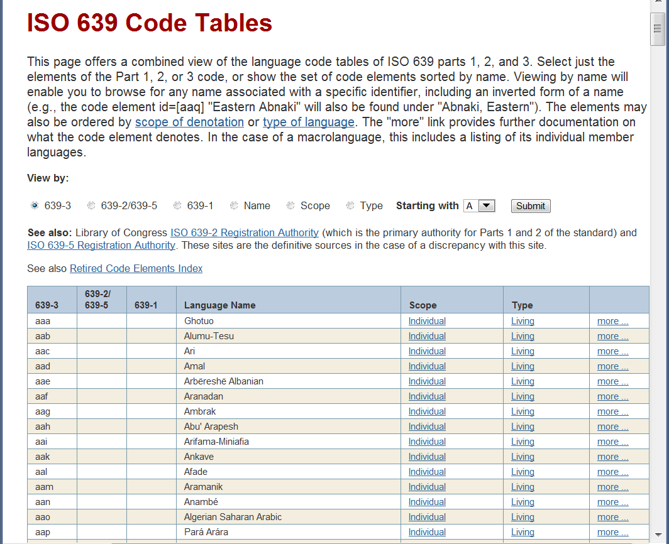
Language Code (ISO 639)
http://www-01.sil.org/iso639-3/codes.asp (DEMO)

Slide 15
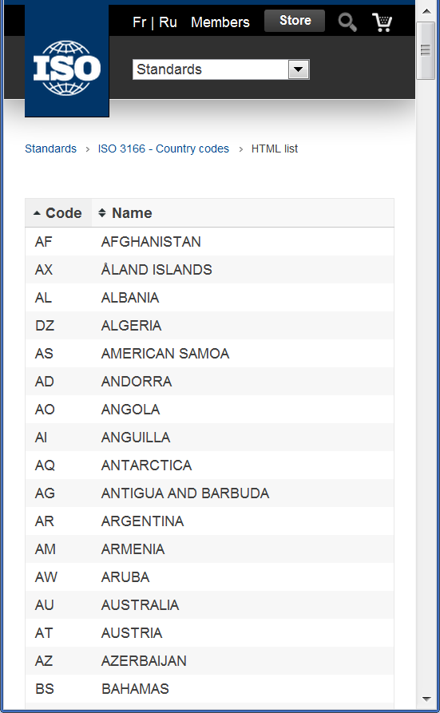
Country Code (ISO 3166)
http://www.iso.org/iso/country_codes.htm (DEMO)
Table of Country Codes
text, xml, html formats

Slide 16
Locale – Configurable parameter
Why do we need both – Country and Language – to specify a Locale?
Are these two details sufficient enough?
Are these standards latest?
These are still evolving. The current / latest BCP (Best Current Practice) is http://en.wikipedia.org/wiki/BCP_47

Slide 17
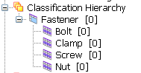
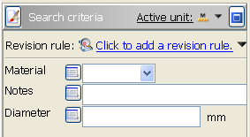
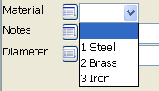
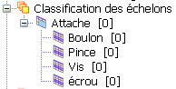
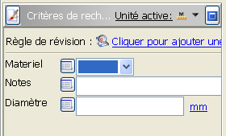
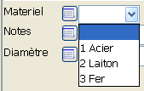
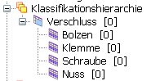
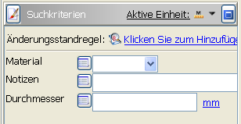
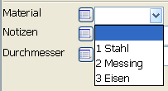
Localization of User interface
Groups & Classes
Attributes
List of Values
English
French
German

Slide 18
On to our next topic …..
Repeat three times.
“Following is totally wrong”
plain text = ascii = characters are 8 bits = characters are 1 byte

Slide 19
ASCII
Developed by ANSI (American National Standards Institute)
Defined in ANSI document X3.4-1977
7-bit code
8th bit is unused (or used for a parity bit or to indicate “extended” character set)
2⁷ = 128 different codes
Two general types of codes:
95 are “Printing” codes (displayable on a console)
33 are “Control” codes (control features of the console or communications channel)
Represents
Latin alphabet, Arabic numerals, standard punctuation characters
Plus small set of accents and other European special characters (Latin-I ASCII)

Slide 20
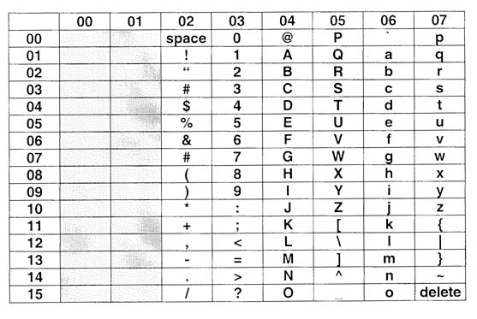
The 7-bit ASCII-code

Slide 21
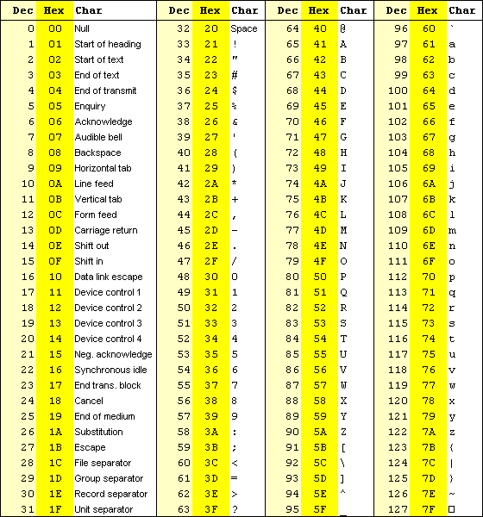
ASCII Chart
This ASCII chart illustrates Decimal and Hex representation of numbers, text and special characters
Hex can be easily converted to binary
Upper case D is 44₁₆
4₁₆ is 0100₂
Upper case D is then 0100 0100 in binary

Slide 22
Extended ASCII
Later developed extended 8-bit versions of ASCII have 256 characters, in order to code further, partial country dependent special characters.
Unfortunately there are however very different versions, which differ from one to another
Everyone from different countries got the same idea “WOW! The numbers from 128 to 255 are unused. Let me use them!”

Slide 23
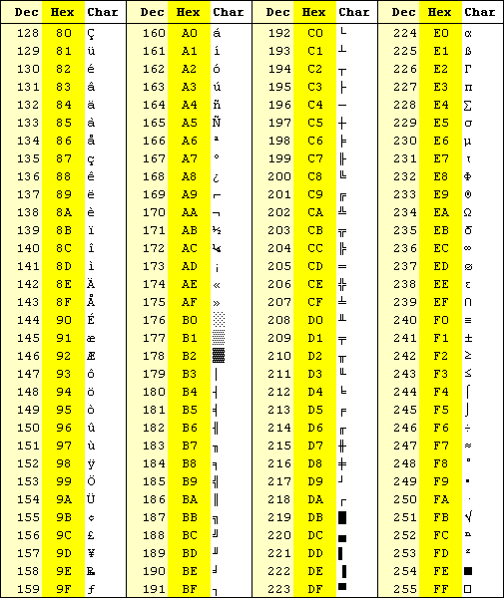
Extended ASCII (Cont…)
From 128 to 255
Many accented characters of Western-European (German, French, Spanish) show up here

Slide 24
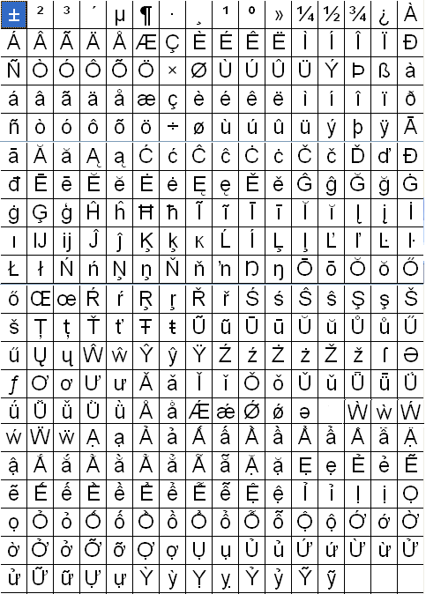
Western-European Languages
(English + Accented Characters)
French
Italian
Polish
Portuguese
Spanish
Romanian
German
Dutch
Greek
Albanian
Swedish
Danish
Norwegian
Icelandic

Slide 25
Background: Root of all problems
In the early days of computing, all the business logic assumed English (or characters that occupy only one byte). So, ASCII encoding worked (0 to 127 characters)
When the entire world is adopting, different countries / languages took liberty of interpreting the ASCII code points (128 to 255 and up) and gave them different meanings. There is no standard
So, the numbers from 128 to 255 have different meanings in Russian, Greek, Spanish, etc..
So, when any deployment need to work in both multiple languages (say Chinese and Spanish; or Korean and Russian) all the problems came to surface – due to data corruption, data truncation, unable to display
So you may see gibberish, ? Or little itty bitty squares or some other mess.

Slide 26
Why is “ASCII is OK” a big problem?
Byte Vs Character Schema
In your database design, what do you mean by VARCHAR(20) for a column?
2. String Manipulation APIs
When you want a String of 10 characters, what does it mean?
Is it 10 code points?
Is it 10 logical characters?
How are your string processing functions going to work on multi-byte characters?

Slide 27
Unicode – The Solution
Then came Unicode: Where all the characters have one and only code point (over million characters);
Just imagine a big database or an array with an index. If you query an index, you are guaranteed that you will be given information about the corresponding character
Note that these code points are NOT same as encodings (we will discuss it later on)
If you want to have deployment that supports multiple languages that belong to different character sets (eg: Russian and Chinese) then relying on Unicode is the only option you have.

Slide 28
Capital A in Unicode
0041: LATIN CAPITAL LETTER
A
Representative glyph
Code point: 0041 Name: LATIN CAPITAL LETTER A General category: Uppercase letter (Lu) Canonical combining class: Standard spacing (0) Bidirectional category: Left-to-right (L) Mirrored: no (N) Lowercase mapping: 0061
Semantic properties

Slide 29
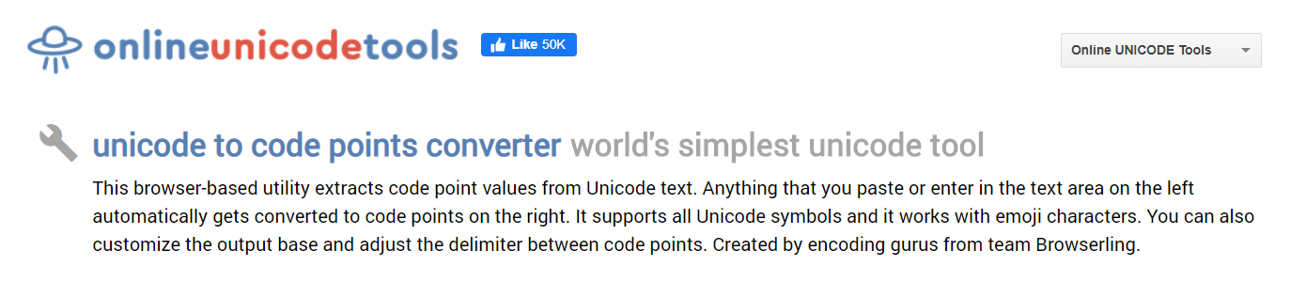
An online tool to play with Unicode
https://onlineunicodetools.com/

Slide 30
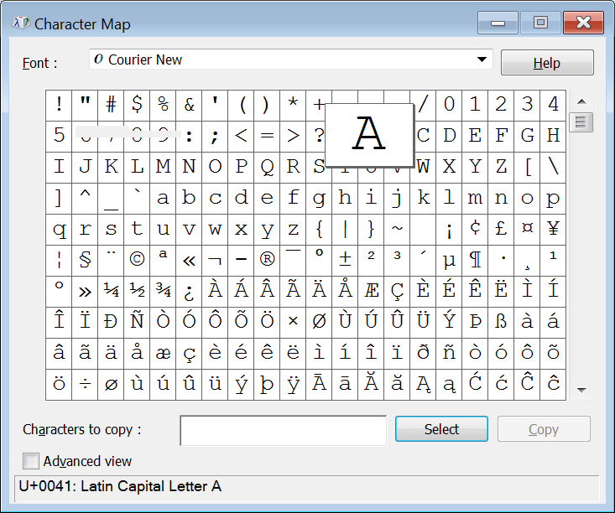
Utility – charmap (on windows)

Slide 31
Summary
ASCII / Assuming a character occupies a single byte is the root of all evils
Such assumption will lead to several issues – disabling I18N
Byte Vs Character Schema
String Manipulation APIs
3. Unicode (code points) and UTF-8 (Encoding schemes) is the solution to overcome this issue
.

Slide 32
Acronyms
IANA: Internet Assigned Numbers Authority
LISA: Localization Industry Standards Association
ISO: International Standards Organization
ICU: International Components for Unicode
UTF: Unicode / Universal Transformation Format
UCS: Universal Character Set
IETF: Internet Engineering Task Force
BCP: Best Current Practice (BCP 47)
CLDR: Common Locale Data Repository
LDML: Locale Data Markup Language
DBCS: Double Byte Character Set
OEM: Original Equipment Manufacturer
ANSI: American National Standards Institute

Slide 33
References
Joel on Software
http://www.joelonsoftware.com/articles/Unicode.html
Sun Globalization Resources
http://developer.sun.com/techtopics/global
MultiLingual Computing & Technology magazine
http://www.multilingual.com
The Unicode Consortium
http://unicode.org
I18n Guy's I18n and L10n Portal
http://www.i18nguy.com

Slide 34
Some important things you need to remember ..
Character = 1 byte / a,b,c (NOT OK)
Logical Character = can be multiple bytes / String (OK)
All the APIs need to handle the logical characters / strings (Unless otherwise explicitly called for, all of the APIs and logic handles only Strings (words and logical characters)
All the files you read are in UTF-8 encoding
FONT should be configurable; Do not hard code the FONT
Text can be copy and pasted or Typed using different input methods

Slide 35

Q&A
Notes:
35

